Slide 1
Algorithm Efficiency Analyzer Tool - Unveiling the Power of Sorting Algorithms
Team 1
CPSC 535: Advanced Algorithms

Slide 2
Introduction
What is the importance of algorithm efficiency.
Speed, Resource Utilization, Scalability, Cost Reduction, User Experience
Efficient algorithms save time, critical for real-time applications like gaming and simulations
They use fewer resources which is crucial for mobile devices and battery-powered systems
Handle large data and complex inputs, vital for data analysis and growth.
Reduce infrastructure costs in cloud computing and data centers by using efficient algorithms.

Slide 3
How sorting algorithms impact various applications.
Databases – QuickSort, MergeSort, or HeapSort enable faster data retrieval in databases.
Search Engines – Efficient sorting algorithms improve search result ranking and response times.
Data Analysis – RadixSort and external sorting handle big data in analytics efficiently.
Operating Systems – Sorting organizes file listings, enhancing user experience.
Financial Markets – Optimize network paths for reduced congestion and faster data transfer.

Slide 4
Team Introduction
GUI Development (Keshav and Vedita): As the GUI Developers, Keshav and Vedita were responsible for designing an intuitive and user-friendly interface.
Algorithm Implementation and Testing (Akash and Vaishnavi): Akash and Vaishnavi assumed the roles of Algorithm Specialists and Testing Leads.
Data Visualization (Preetham and Mourya): Preetham and Mourya specialized in Data Visualization.
Documentation and Presentation (Navya and Nikhil): Navya and Nikhil took on the roles of Documentation and Presentation Leads.

Slide 5

Tools and Technologies
Our project was predominantly developed using Python, a versatile language suitable for algorithm implementation and data visualization.
We employed Python's matplotlib library for creating insightful visualizations.
The GUI was designed using frameworks like Tkinter depending on team members' preferences and familiarity.
CircleCI is a continuous integration and continuous delivery (CI/CD) platform that automates the software development process. It helps development teams build, test, and deploy their code more efficiently and reliably.

Slide 6
Graphical User Interface
Python script introduces an interactive GUI utilizing the tkinter library to explore sorting algorithm efficiency.
Users can input data, choose sorting algorithms, execute them, and visualize results. It employs input validation, array generation, and real-time plotting with matplotlib.
The GUI fosters algorithm understanding and analysis. It imports necessary libraries, handles user input, enables algorithm selection, times executions, and displays comparative plots. Customization options enhance the GUI's appearance, making it a valuable tool for learning and analysis.

Slide 7
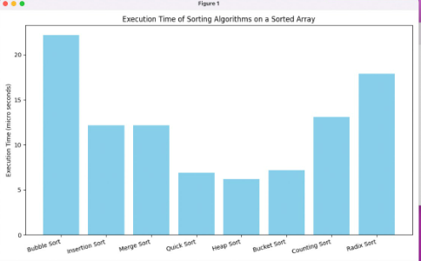
Data Visualization
Matplotlib is used to create animated bar graphs illustrating the execution times of sorting algorithms.
Import libraries, prepare data, create the graph, customize it, and animate it to show algorithm complexity changes over time.
Color coding highlights differences among algorithms, making it visually insightful.
Matplotlib's versatility allows us to present dynamic, educational visualizations.

Slide 8
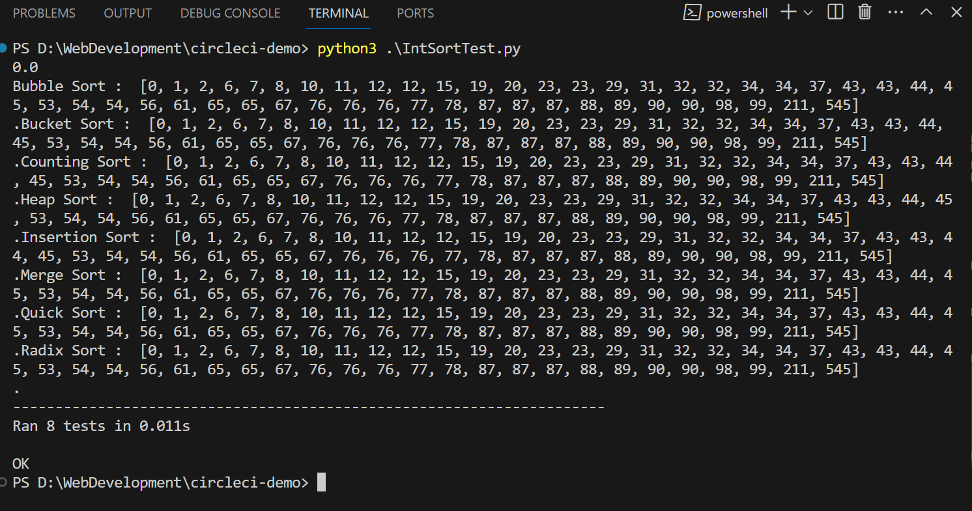
Testing
“IntSortTest.py” is a unit testing script designed to evaluate the functionality and performance of different sorting algorithms implemented in the “SortInteger.py” module.
It utilizes the “unittest” framework to define a series of test cases, each corresponding to a specific sorting algorithm such as insertion sort, bubble sort, merge sort, heap sort, bucket sort, counting sort, quick sort, and radix sort.

Slide 9

Why to use CI/CD Pipeline:
Continuous Integration/Continuous Deployment (CI/CD) is a software development practice that automates the building, testing, and deployment of code changes, ensuring rapid and reliable delivery of software updates while maintaining high quality and minimizing human error.
In our project “config.yml” is a configuration file for CircleCI, a continuous integration and continuous deployment (CI/CD) platform. This configuration file specifies the workflow for building and testing our project.

Slide 10
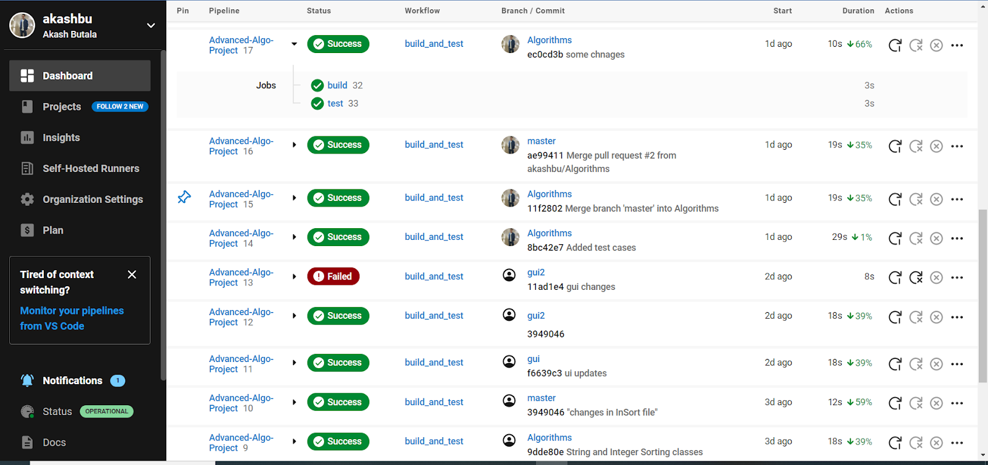
CI/CD workflow:

Slide 11
Challenges faced
Version Control: With multiple team members working concurrently on the project, ensuring that code changes were integrated seamlessly and without conflicts posed a significant hurdle.
Code Integration Problem: Integrating various components of the tool, including the GUI, algorithm implementations, data visualization, and testing suites, proved to be a complex undertaking.
Code Execution: Another challenge we encountered was related to code execution, where specific portions of the code were functioning correctly while others remained blocked.
Documentation Consistency: Maintaining consistent and up-to-date documentation throughout the project, including code comments, and documentation, can be challenging, especially when code evolves rapidly.

Slide 12
Future Developments
Additional Sorting Algorithms: Add more types of sorting methods to the tool, even the less common ones, to help users learn and compare different algorithms.
Algorithm Complexity Analysis: Add features that explain how algorithms work, including how fast they are and how much computer memory they need.
Visual Customization: Let users change how the graphs look - they can pick different types, colors, and styles that they like.
Algorithm Comparison: Add a feature that lets users compare several algorithms at once, so they can see how they perform side by side.

Slide 13

Thank You

